Slide 1


NALAIYA THIRAN - Project Work
M.A.M. COLLEGE OF ENGINEERING AND TECHNOLOGY
Siruganur, Tiruchirappalli – 621 105.
Project Title: AI- POWERED NUTRITION ANALYSER FOR FITNESS ENTHUSIASTS
Register Number | Name of student
812019205028 | PUSHPA A
812019205047 | SHARMILA A
812019205054 | VANMARAISELVI R
812019205058 | VINOTHINI S
812019205059 | WILLBRIT VINCY X
Under the esteemed guidance of
Mentor Name & Designation: B.Rama,ASP/IT
Evaluator Name & Designation: DR.K.Geetha,Prof&Head/IT
Notes:
Notes for Teachers:
The Synopsis presentation should contain 1. Real life applications 2. Overview of the subject 3. PO’s CO’s of the course 4. Individual Units overview 5. Lesson Plan 6. Flip Class topics
“ Be professionally dressed and use a QUALITY PEN. Never hand an ordinary PEN as a Cosmetic Effect”

Slide 2
Problem Definition
The main aim of the project is to building a model which is used for classifying the fruit depends on the different characteristics like colour, shape , texture etc. Here the user can capture the images of different fruits and then the image will be sent the trained model. The model analyses the image and detect the nutrition based on the fruits like (Sugar, Fibre, Protein, Calories, etc.)

Slide 3
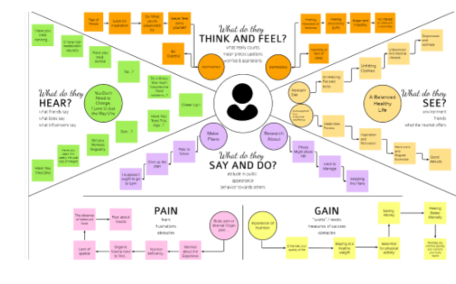
Empathise & Discover

Slide 4
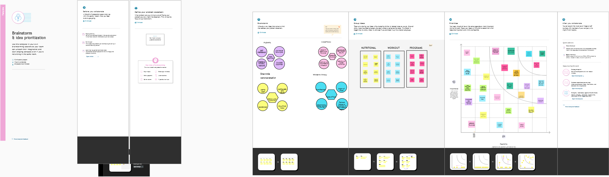
Brainstorming

Slide 5
Proposed solution
It will generate the diet plan as well as monitor the user’s health to classify the category of the disease and to create the diet plan. It will also reduce the cost of consulting the person nutritionist. The task of food detection/classification is not easy as it seems. All possible options related to the given Image .we use the Image classification method.

Slide 6
Problem solution fit
The Problem-Solution Fit simply means that you have found a problem with your customer and that the solution you have realized for it actually solves the customer’s problem. It helps entrepreneurs, marketers and corporate innovators identify behavioural patterns.
PURPOSE:
Solve complex problems in a way that fits the state of your customers.
Succeed faster and increase your solution adoption by tapping into existing medium sand channels of behaviour.
Sharpen your communication and marketing strategy with the right triggers and messaging.
Increase touch-points with your company by finding the right problem-behaviour fit and building trust by solving frequent annoyances, or urgent or costly problem.

Slide 7
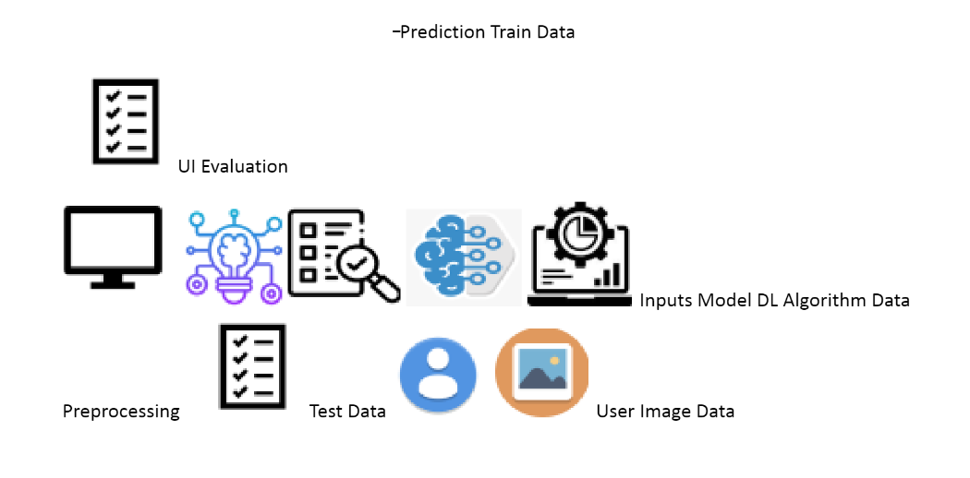
Solution Architecture

Slide 8
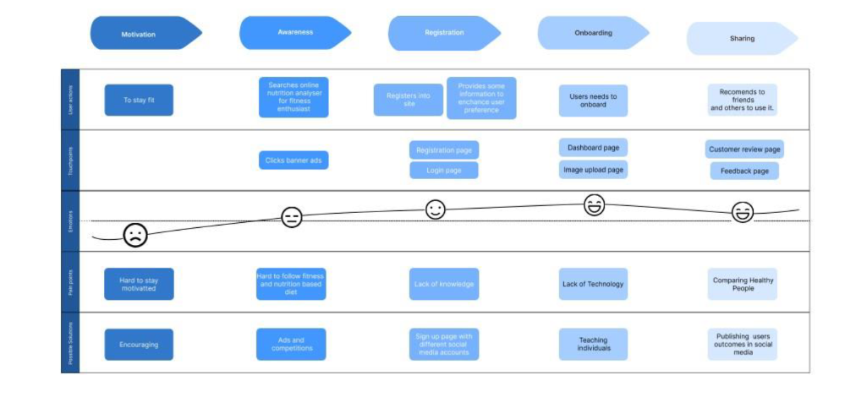
Customer Journey Map

Slide 9
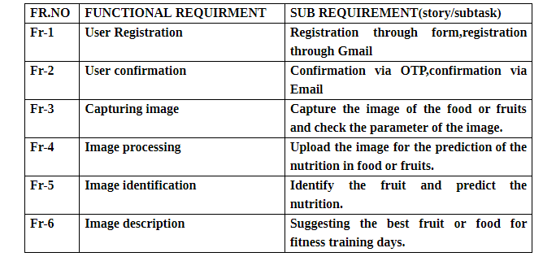
Functional & Operational Requirements

Slide 10
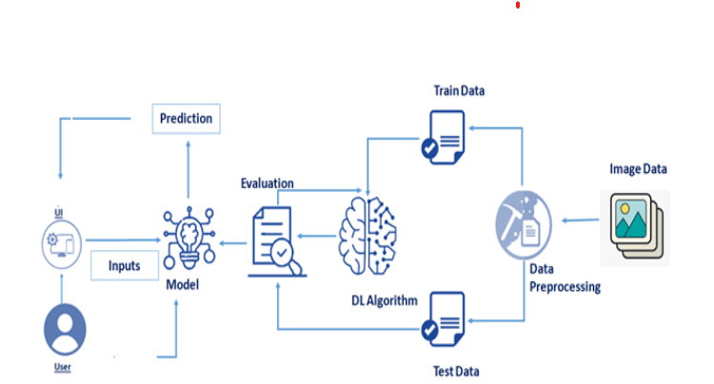
Technical Architecture

Slide 11



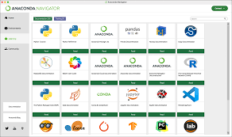
Open source Framework Used

Slide 12


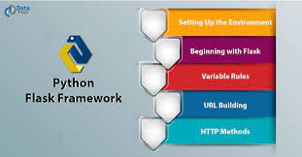
Third Party API

Slide 13
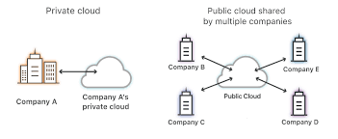
Cloud Deployment
Public cloud As the name suggests, this type of cloud deployment model supports all users who want to make use of a computing resource, such as hardware (OS, CPU, memory, storage) or software (application server, database) on a subscription basis.

Slide 14
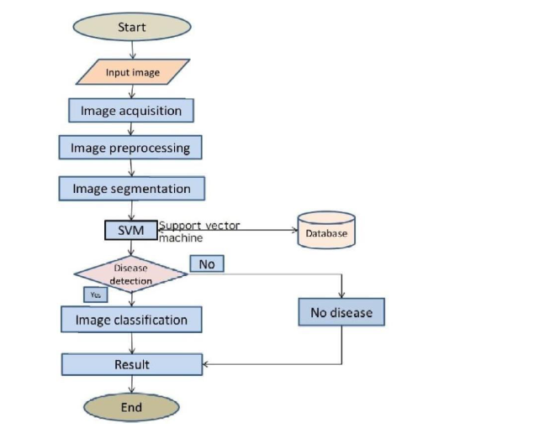
Project Progress Tracking

Slide 15
Project Milestone & Task
Modern Technology are increasing and optimizing the Performance of the Artificial Intelligences (AI) Model. To build a model which is used for classifying the fruit depends on the different characteristics like colour, shape, texture etc.
TASK:
task 1: Information Collection and Requirement Analysis.
task 2: Project Planning and Developing Modules.
task 3: Implementing the High Accuracy Deep Learning Algorithm to Perform.
task4: Deploying the Model on Cloud and Testing the Model and UI Performance

Slide 16
Sprint Delivery Plan
SPRINT NO | FUNC REQUIREMENT | USER STORY NO. | USER STORY/TASK | STORY POINTS | PRIORITY | TEAM MEMBERS
SPRINT 1 | Data collection | USN-1 | Collecting the image from the users | 4 | High | Sharmila Pushpa
SPRINT 2 | Modelling phase | USN-2 | Designing and building the model architecture using CNN | 5 | Medium | Vanmaraiselvi Vinothini Willbrit Vincy
SPRINT 3 | Development phase | USN-3 | Project development of sprints | 4 | High,medium,low | Vanmaraiselvi Vinothini
SPRINT 4 | Testing and output | USN-4 | Test and find the result | 3 | High , medium | Sharmila Pushpa

Slide 17


Project Planning Tool

Slide 18
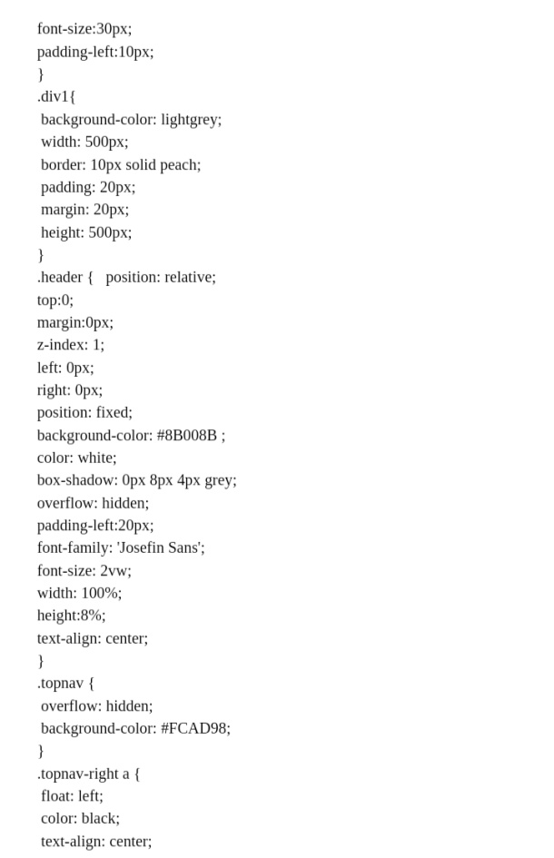
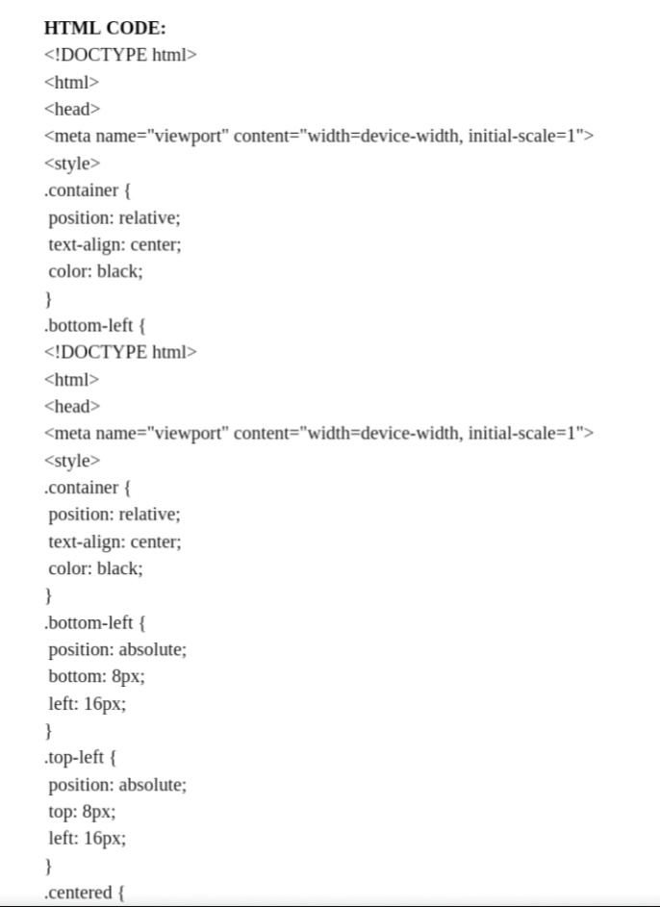
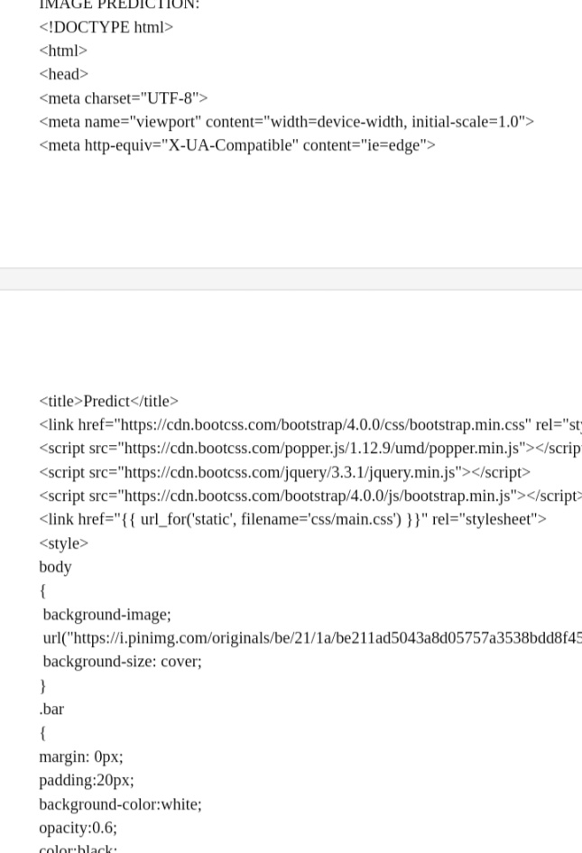
Coding & Solutioning

Slide 19
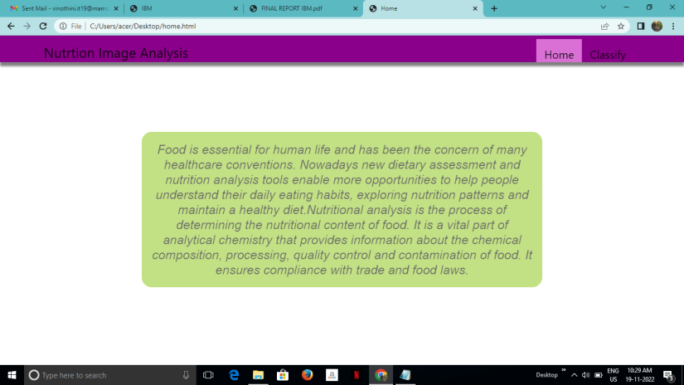
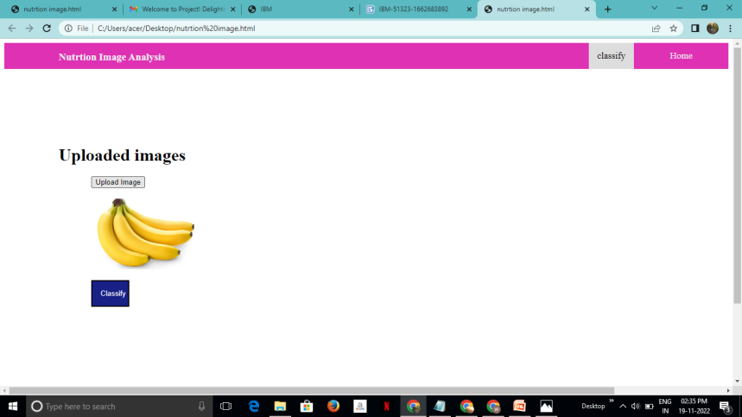
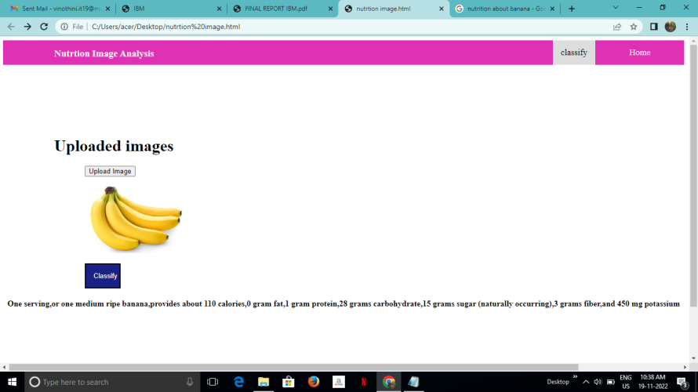
Continue…

Slide 20
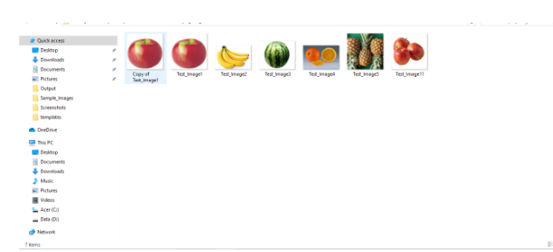
Acceptance Testing

Slide 21
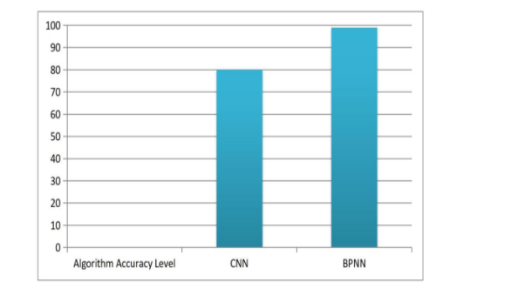
Performance Metrics

Slide 22
Project Demonstration
Drive link of the Project Demonstration has to be included
https://drive.google.com/drive/folders/1Cank6PxaYakJjm2RIJHCCCMCYsS6hzBm

Slide 23
Project Documentation
Drive link of the Project Documentation has to be included

Slide 24

Thank You

